Slide 1


Solar UAV 1/3rd Update
September 26th, 2022

Slide 2







Our Team
Mitchell Anderson: Project Manager and Airfoil/Aircraft Design
Joel Freedman: Logistics Manager/Test Engineer and Wing Selection/Flight Control Design
Gage King: CAD Engineer/Manufacturing and Engine/On-Board Component Selection Design
Radley Rel: Financial Manager and On-Board System/Solar Design
Gabriel Martin : Electrical Engineering Lead
Sultan Alhazawbar: Electrical Engineering Team
Kelly Gallagher: Industry Advisor

Slide 3
Agenda
Design Efforts
Manufacturing Plan
Demonstration
Purchasing Plan
Next Steps
Questions

Slide 4

Project Description
Team Goal: The goal of this project is to design and manufacture a Solar Powered Unmanned Aerial Vehicle (UAV) that can fly 1.5X its battery capacity.
Importance: Offers a huge opportunity to not only design an aircraft and fly it successfully, but to power it with renewable solar energy.
Client: David Willy

Slide 5
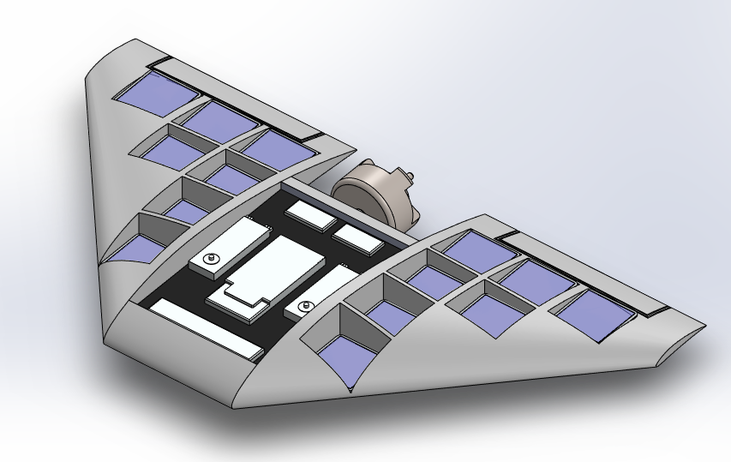
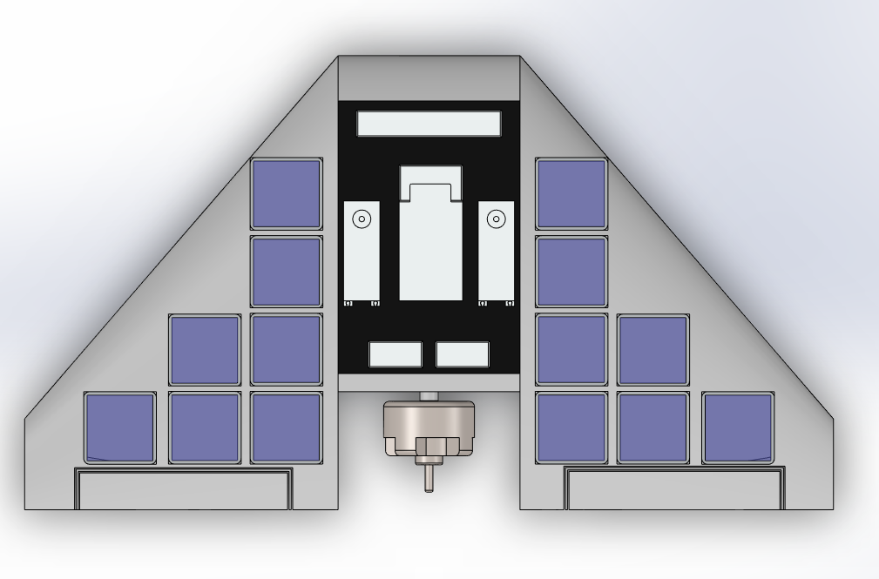
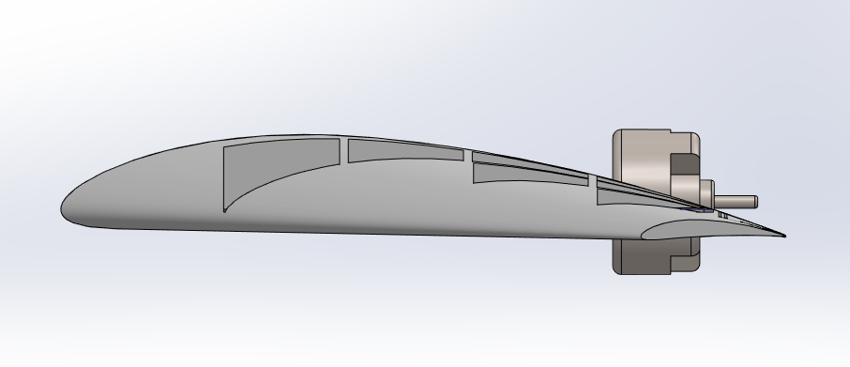
Design Efforts (CAD/Electrical Model)

Slide 6
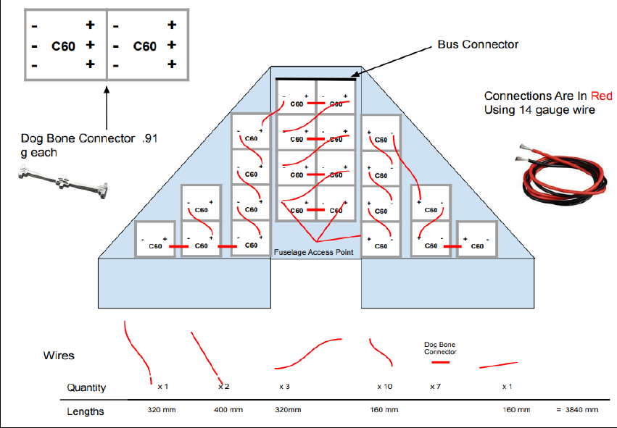
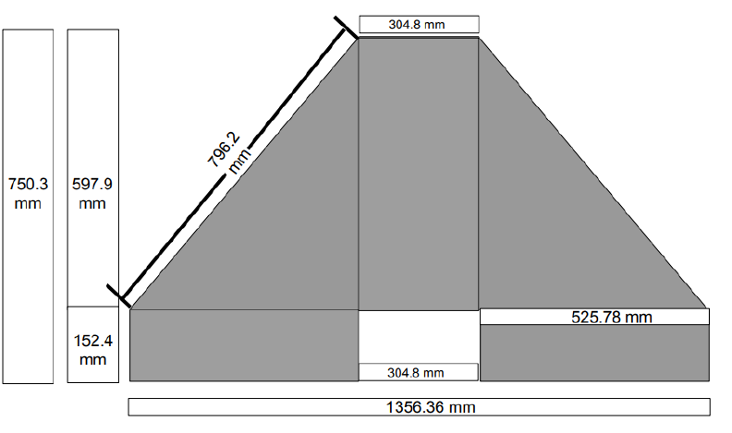
Design Efforts
Delta Wing
CLARK-Y Airfoil
24 C60 Panels
4.45 ft wingspan
1.95 ft fuselage

Slide 7
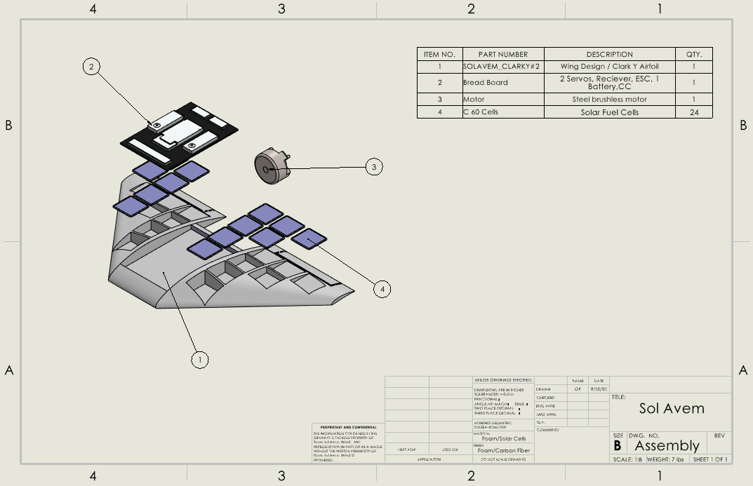

Slide 8
Purchase Plan (Bill Of Materials)
 |  |  | Bill of Materials
 |  | Part # | Description | Quantity | Mass (g) | Who/When | Material | Where | Source
Purchased | 1 | 1 | Motor | 1 | 189.1 | Team/Done | Copper/Elect. | from Source | www.horizonhobby.com
components | 1 | 2 | Prop | 1 | 22.96 | Team/Done | Plastic | from Source | www.horizonhobby.com
 | 1 | 3 | Servo | 2 | 13.4 | Team/Done | Plastic/Elect. | from Source | www.horizonhobby.com
 | 1 | 4 | Radio Reciever | 1 | 27.22 | Team/Done | Plastic/Elect. | from Source | www.amazon.com
 | 1 | 5 | Battery | 1 | 57 | Team/Done | Plastic/Elect. | from Source | www.horizonhobby.com
 | 1 | 6 | Solar Cells | 4 | 20 | EE Team/ 67% Check | Plastic/Elect. | from Source | www.digikey.com
 | 1 | 7 | Speed Controller | 1 | 14.8 | Team/Done | Plastic/Elect. | from Source | www.horizonhobby.com
 | 1 | 15 | Hardware | 1 | 15 | Team/End of Proj | Tape/Glue/Etc. | Various
 | 1 | 16 | Flap Hinges | 2 or 4 | 20 | Team/66% Build | Plastic/Wood | TBD
Manufactured | 2 | 8 | Airfoil | 2 | 22.1 | Mitch/33% Check | Foam | Home/Egr | www.amazon.com
components | 2 | 10 | Chasis (Fuselage) | 1 | 40 | Radley/33% Check | Foam | At home with Hotwire
 | 2 | 11 | Chasis (Shell) | 1 |  | Joel/33% Check | Resin+Fibers | Home/Egr | www.amazon.com
 | 2 | 13 | Chasis (Wings) | 1 | 100 | Gage/33% Check | Foam | At home with Hotwire
 | 2 | 14 | Wiring harness | 1 | 30 | Team/33% Check | Copper Wire | Home/Egr | https://cedflagstaff.portalced.com/

Slide 9
Running Purchases
# | Name | Quantity | Cost
1 | VOLANTEX RC PLANE | 1 | $98.25
2 | Poly Panel Steyrofoam | 1 | $17.50
3 | Glue Gun | 1 | $6.87
4 | DEWALT SMALL TRIGGER CLAMP | 4 | $27.08
5 | SQUARE EMPIRE POLYCAST RAFTER | 1 | $4.47
6 | 130-Watt Hot Knife | 1 | 21.83
7 | Avian 4260-480Kv Outrunner Brushless Motor | 1 | $109.17
8 | Electric Propeller, 13 x 10E | 1 | $10.32
9 | Thin Electric Propeller, 15 x 6E | 1 | $12.73
10 | Avian 45 Amp Brushless Smart ESC, 3S-6S | 1 | $69.86
11 | HS-430BH Standard Analog HV Deluxe Servo | 2 | $43.64
12 | 22.2V 3200mAh 6S 50C Smart G2 LiPo Battery: IC5 | 1 | $97.15
13 | DXS Transmitter with AR410 Receiver | 1 | $163.76
14 | HTRC LiPo Battery Charger RC Car Balance Charger, 1S-6S Digital Discharger Battery Pack Charger 80W 6A for Li-ion Life NiCd NiMH LiHV PB Smart Battery,Deans Connectors + Power Supply | 1 | $52.37
15 | Hotwire components | 1 | $66.60
16 | Prototype foam EPS | 3 | $85.14
17 | Spektrum Ws2000 Wireless USB RC Flight Simulator Dongle | 2 | $94.66
18 | Real Flight 9 (RC Simulator) | 1 | $105.59
19 | PolyStyrene 2"x4'x8' | 1 | $31.66

Slide 10
Budget Amount |  | $2,000
Money Spent |  | $1,598.96
Amount Left |  | $401.04

Slide 11
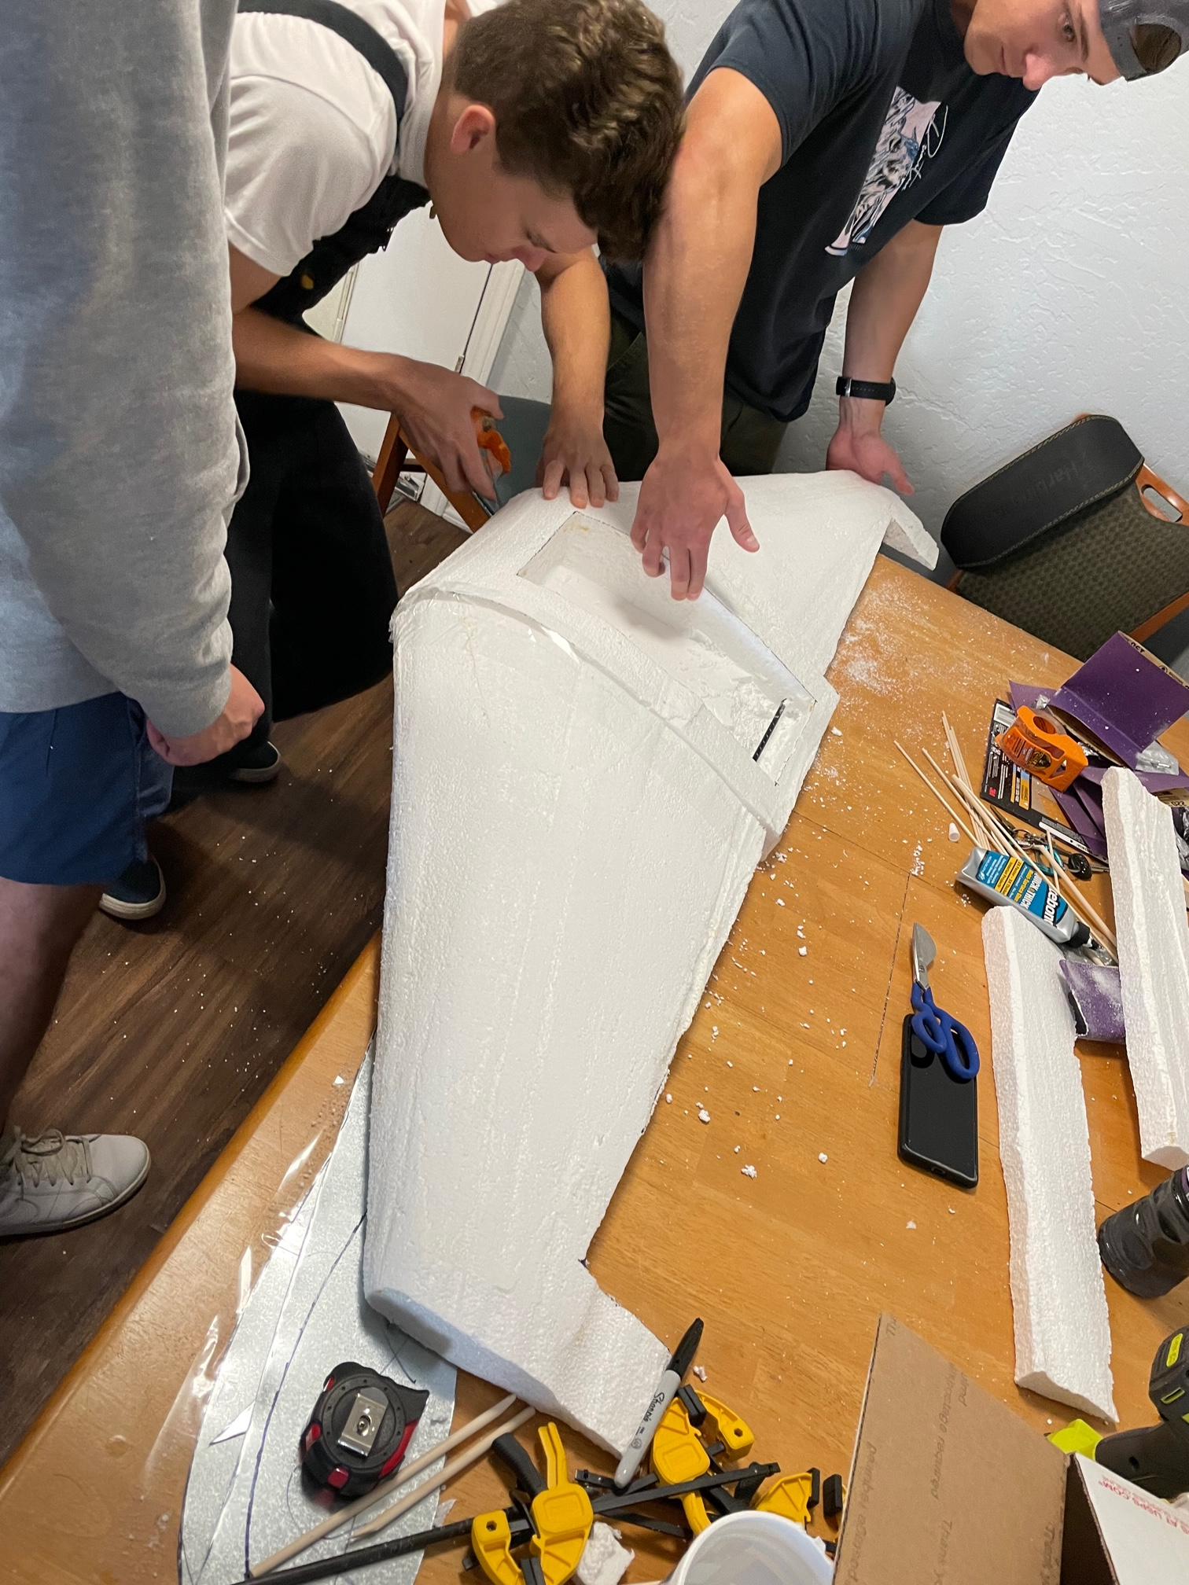
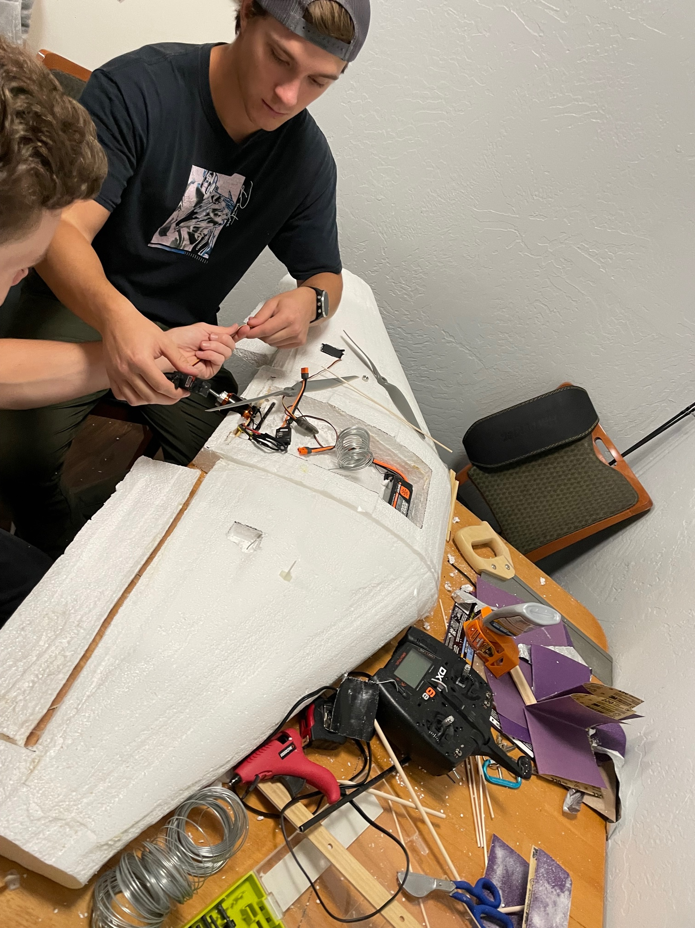
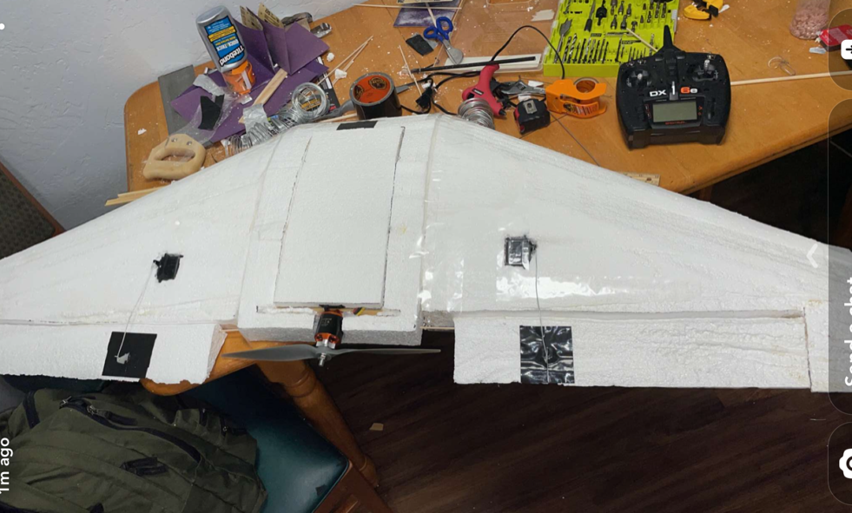
Manufacturing Plan
Hotwire
Sheet metal airfoil
EPS Styrofoam
Carbon fiber support
Packing tape laminate
Control systems mounted

Slide 12
Demonstration
Throttle Test
Explain where and what components are in the aircraft
Alleviator Test

Slide 13

Next steps
Glide Test
Flight Tests
Manufacturing Reinforcement
Possible Design Changes

Slide 14
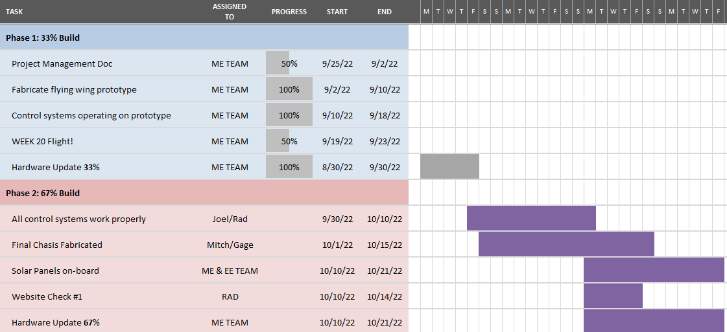

Slide 15

Questions?

Slide 16
Appendix

Slide 19
# | Name | Quantity | Cost
1 | VOLANTEX RC PLANE | 1 | $98.25
2 | Poly Panel Steyrofoam | 1 | $17.50
3 | Glue Gun | 1 | $6.87
4 | DEWALT SMALL TRIGGER CLAMP | 4 | $27.08
5 | SQUARE EMPIRE POLYCAST RAFTER | 1 | $4.47
6 | 130-Watt Hot Knife | 1 | 21.83
7 | Avian 4260-480Kv Outrunner Brushless Motor | 1 | $109.17
8 | Electric Propeller, 13 x 10E | 1 | $10.32
9 | Thin Electric Propeller, 15 x 6E | 1 | $12.73
10 | Avian 45 Amp Brushless Smart ESC, 3S-6S | 1 | $69.86
11 | HS-430BH Standard Analog HV Deluxe Servo | 2 | $43.64
12 | 22.2V 3200mAh 6S 50C Smart G2 LiPo Battery: IC5 | 1 | $97.15
13 | DXS Transmitter with AR410 Receiver | 1 | $163.76
14 | HTRC LiPo Battery Charger RC Car Balance Charger, 1S-6S Digital Discharger Battery Pack Charger 80W 6A for Li-ion Life NiCd NiMH LiHV PB Smart Battery,Deans Connectors + Power Supply | 1 | $52.37
15 | Hotwire components | 1 | $66.60
16 | Prototype foam EPS | 3 | $85.14
17 | Spektrum Ws2000 Wireless USB RC Flight Simulator Dongle | 2 | $94.66
18 | Real Flight 9 (RC Simulator) | 1 | $105.59
19 | PolyStyrene 2"x4'x8' | 1 | $31.66

Slide 20
# | Name | Purchase Date | Unit Price
1 | Portable Flexible-Solar-Panel-Charger Small Solar Panels 1W 6V | 3/27/2022 | $85.08
2 | Soldering Iron 60W Adjustable Temperature, Digital Multimeter, 5pcs Soldering Tips Kit | 3/27/2022 | $25.99
3 | Renogy Solar Charge Controller 12V/24V Auto MPPT with LCD Backlit Display w/Temp | 3/27/2022 | $87.99
4 | ELEGOO UNO Project Super Starter Kit with Tutorial and UNO R3 Compatible with Arduino IDE | 3/27/2022 | $39.99
5 | Turnigy 1800mAh 2S 20C Lipo Pack | 3/27/2022 | $16.24
6 | Turnigy 2200mAh 3S 25C Lipo Pack | 3/27/2022 | $20.89
7 | Scotch Vinyl Electrical Tape | 3/29/2022 | $1.97
8 | 1A 12V Charge Module, MPPT Solar Panel Controller | 3/29/2022 | $19.61
9 | 100Pcs Dog Bone Tabbing Wire Connector Special for Sunpower Solar Cells Maxeon C60 | 9/9/2022 | $27.30
10 | Vikocell Solar Panel Solder Kit 20M Tabbing Wire with 2M Busbar Wire and 1 Pcs Flux Pen for DIY Solar Cells Soldering | 9/9/2022 | $17.46
11 | Victron Energy BlueSolar MPPT 75V 15 amp 12/24-Volt Solar Charge Controller | 9/9/2022 | $96.52
12 | Sunpower New Solar Cell Flexible Mono Solar Wafer Monocrystalline Cells Tabbing for DIY Solar Panel High Efficiency 3.4W C60 5x5 Safe Packing (40) | 9/19/2022 | $174.14

